Slide 1
Mobile Meals
The Alpha Team
ITSC 6160 Group Project
University of North Carolina at Charlotte

Slide 2
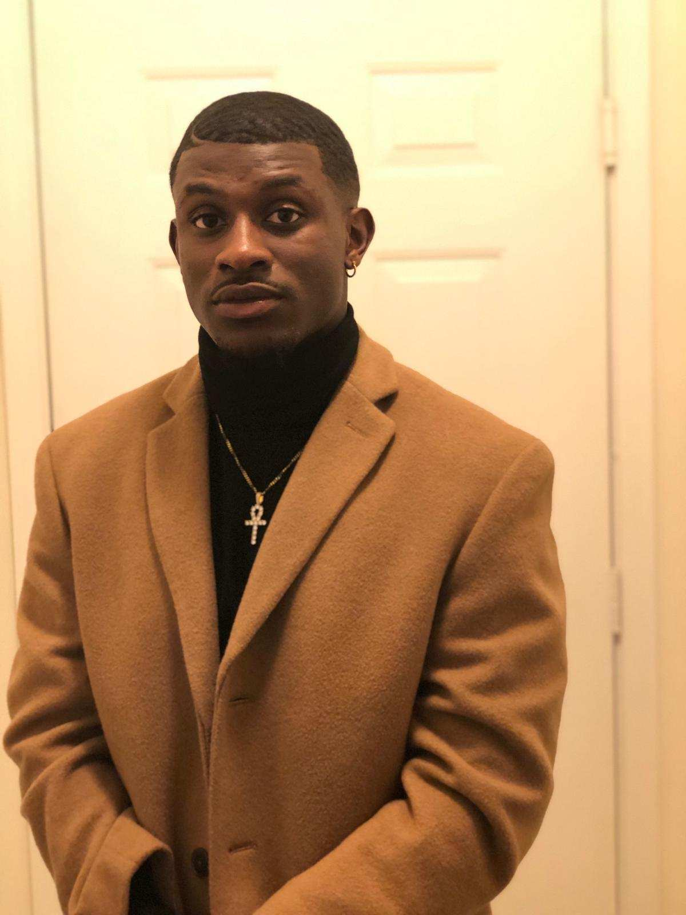
Meet the Team
Anjolaoluwa (AJ) Daodu
Hometown: Raleigh, NC
Major: M.S in Computer Science
Concentration: Information Security and
Privacy
Graduation Year: December 2021

Slide 3
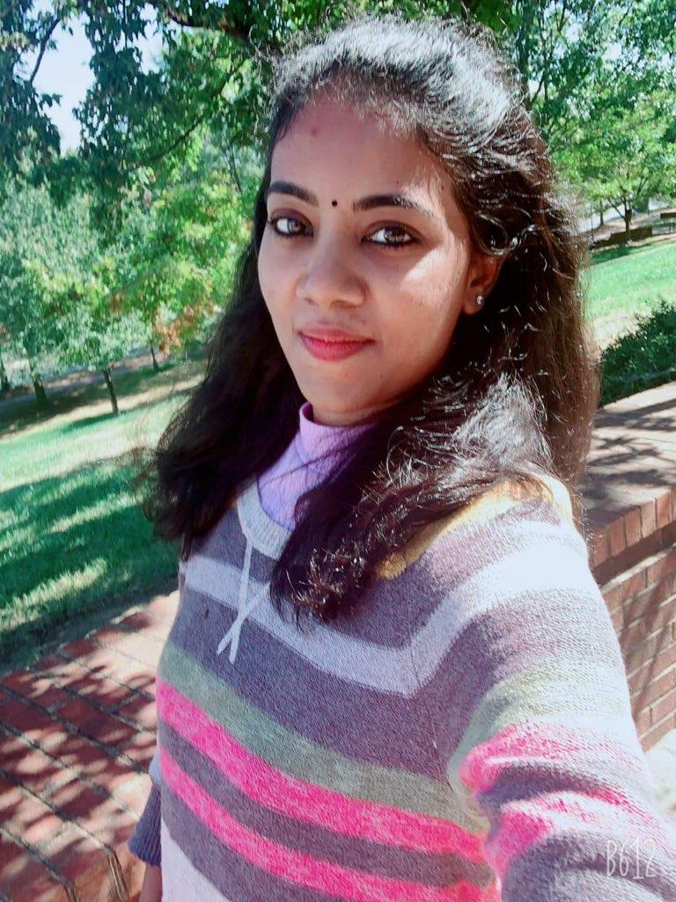
Meet the Team
Nithya Sri Srinivasan
Hometown: Concord, NC
Major: M.S in Electrical and Computer
Engineering
Graduation Year: May 2020

Slide 4
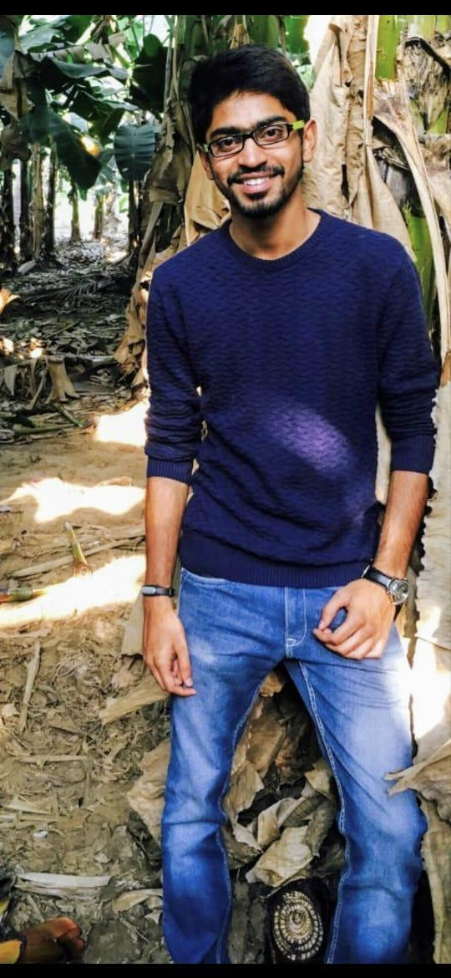
Meet the Team
Vaasant Sreereddy
Hometown: Charlotte, NC
Major: M.S in Computer Science
Concentration: Software, Systems,
and Networks
Graduation Year: December 2020

Slide 5
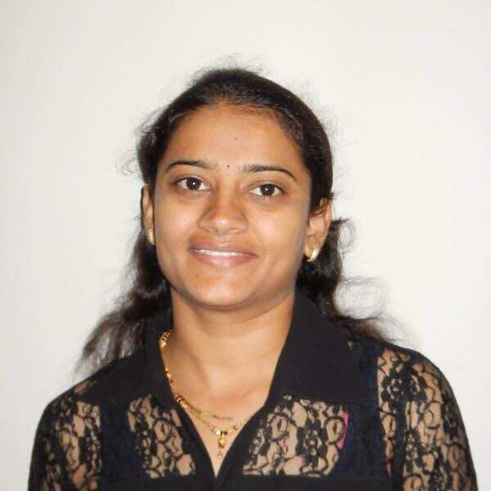
Meet the Team
Hansa Gajera
Hometown: Charlotte, NC
Major: M.S in Computer Science
Concentration: Data Science
Graduation Year: May 2020

Slide 6
Scope
Statement of the Scope for Mobile Meals:
Mobile Meals project scope is to track and maintain database information for meal service providers, meal ordering persons like students, staff and campus faculty, an approved list of driver for meal delivery. We are tracking driver’s data with vehicle he uses along with his latest driver’s license information. Drivers will be rated by on time delivery via Rate My Delivery feature. We will maintain list of locations within the UNCC campus which are considered designated areas as meal pickup/delivery for this project purpose.
Restaurant’s menu items and other detailed database design related to restaurant is out of scope for this project. While we will keep track of approved list of food providers, restaurant as a part of this project to track food providers and their locations.
The transaction of any meal order would be an item with item price as generic billing purpose rather than naming each item separately and billing them separately. For each order there will be additional delivery charge applied as 5$ flat fees while item price will be inclusive of all taxes, tips etc. so we are excluding it from the scope.

Slide 7
Business Rules
Person Type should be master data with person Type Name as Staff, Faculty and student only.
Person table can contain one or many items with same person Type.
Staff, Faculty and Student table can have many to one relation with Person table.
Vehicle table must maintain all the vehicles being used by students for meal delivery.
Driver table should hold student drivers license information and they are IsValidandApproved by default.
License expiry date in Driver table should be future date and must set IsValidandApproved flag to False if its past date.
Driver table must have IsValidandApproved Flag true when new record is added to Drive table.
Driver table must contain list of student drivers whose gradYear is future year and it should raise IsValidandApproved flag to false for past gradyear students.
Meal Deliver Location must be list of locations within UNCC (university campus area).
Each meal order must be associated with deliver location, delivery person and person who order meal.
Each meal provider must be registered to meal provider database for Mobile_Meal application in order to provide/supply meal to campus persons.
.

Slide 8
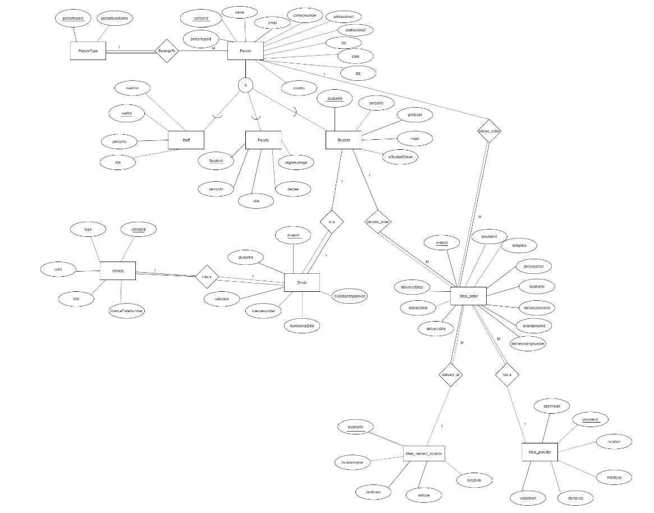
EERD Diagram

Slide 9
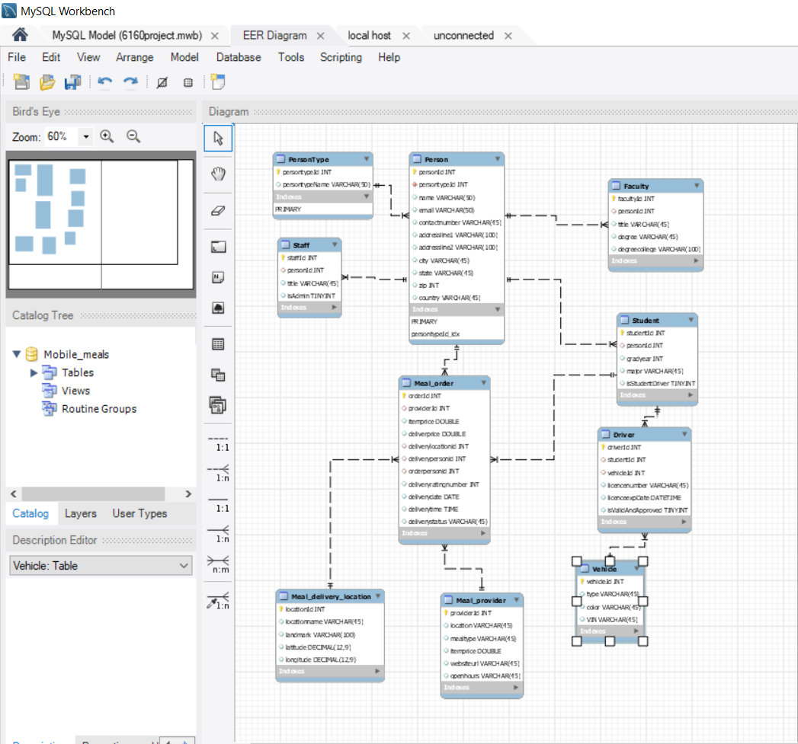
Schema

Slide 10
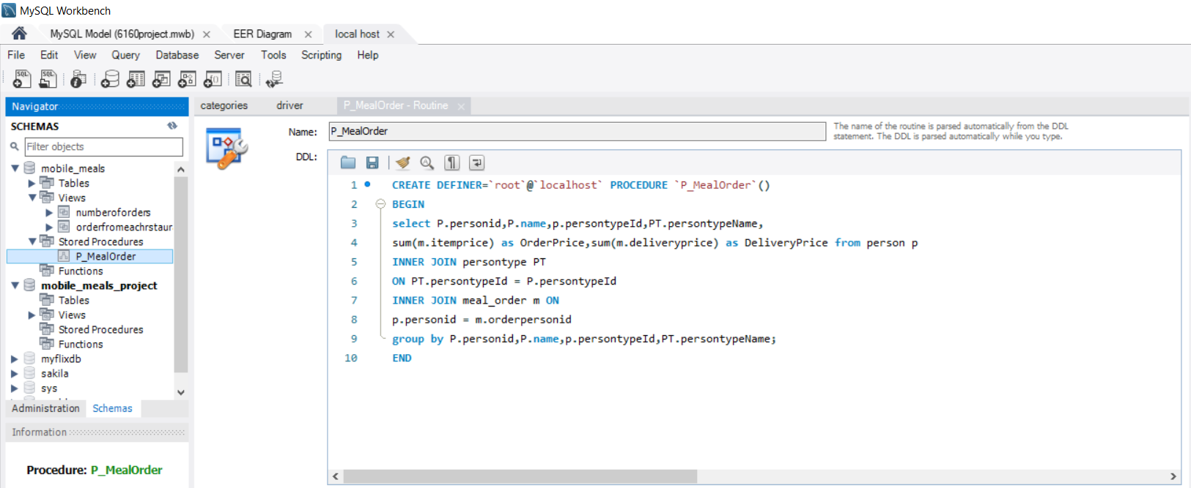
Stored Procedures

Slide 11
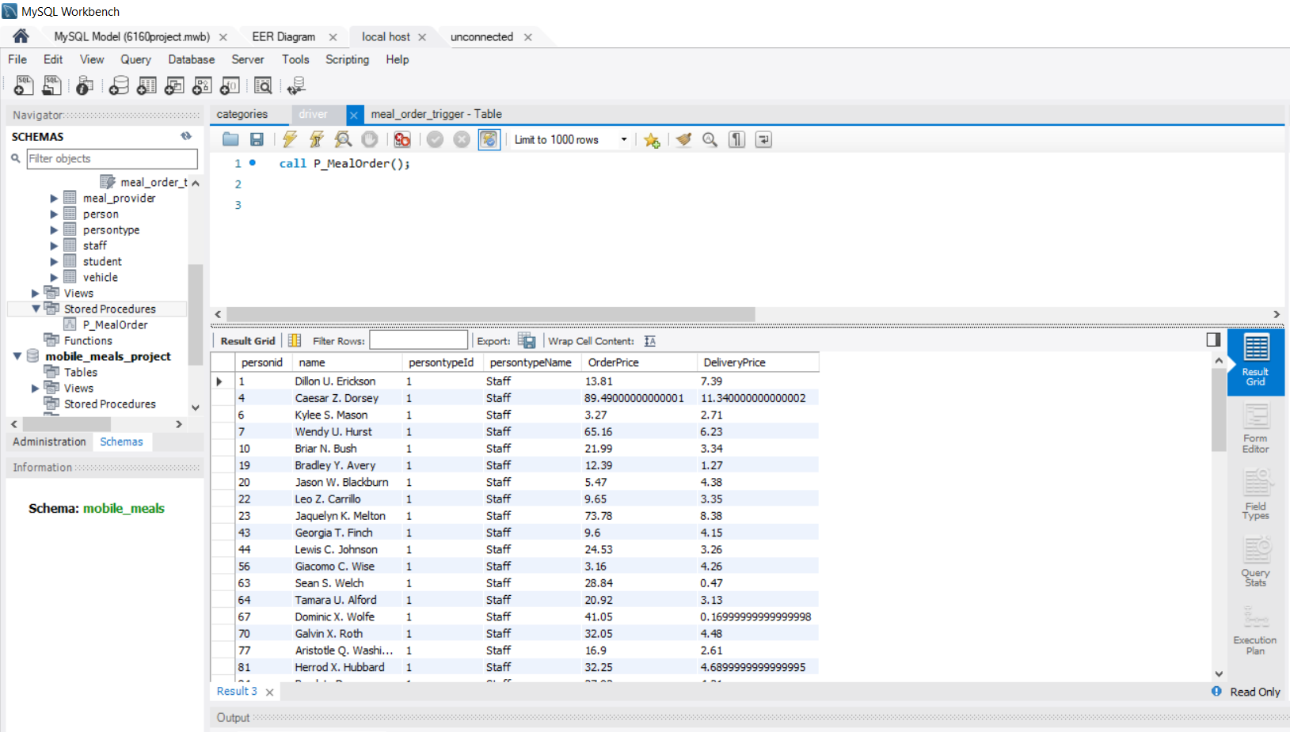
Output for Stored Procedure

Slide 12
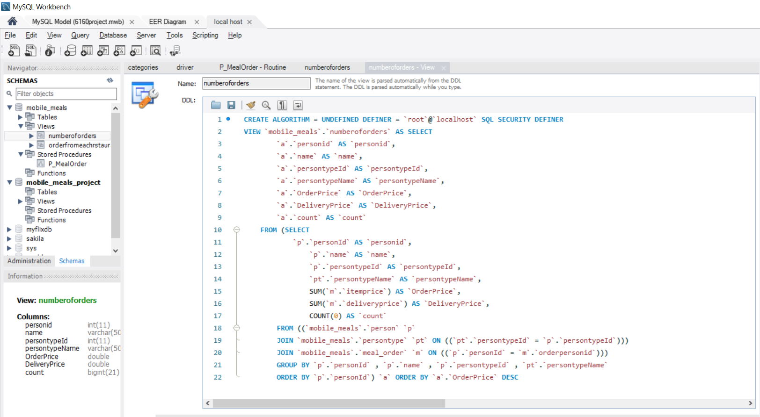
View - 1

Slide 13
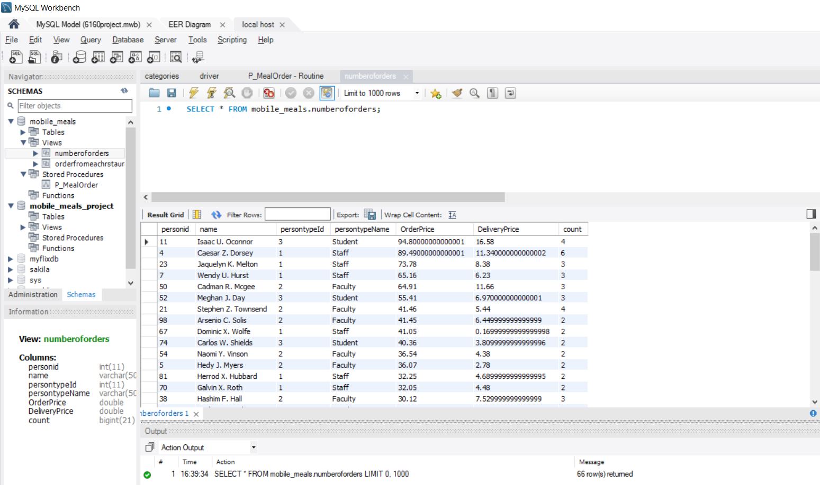
Output for View 1

Slide 14
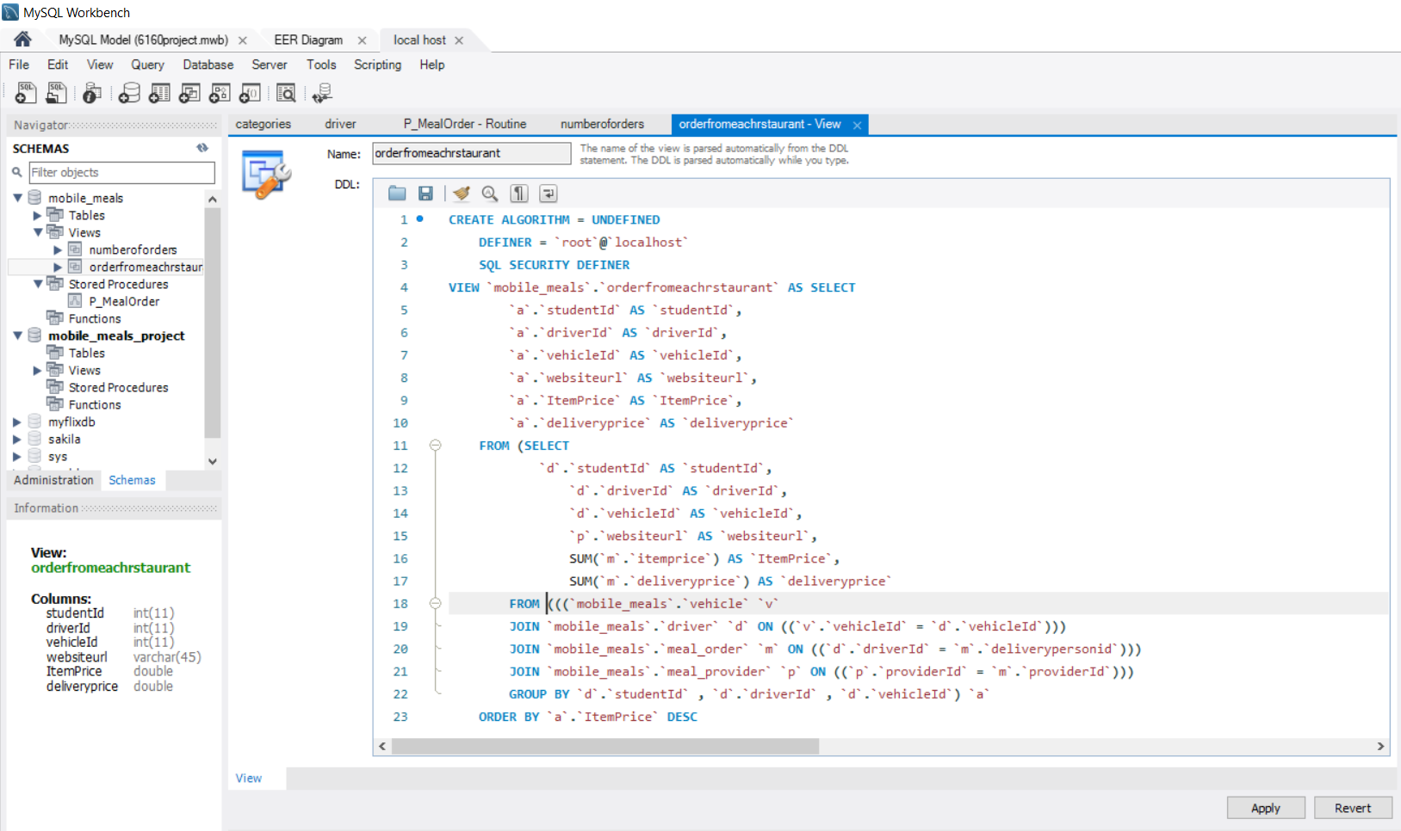
View - 2

Slide 15
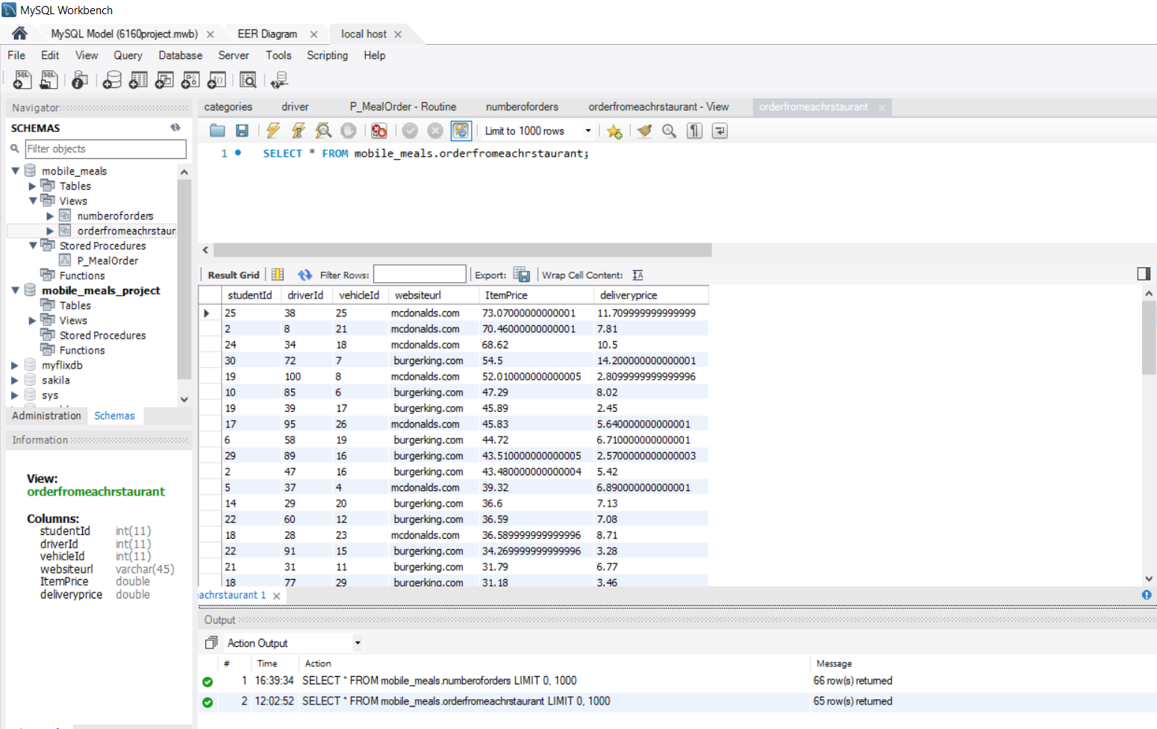
Output for View 2

Slide 16
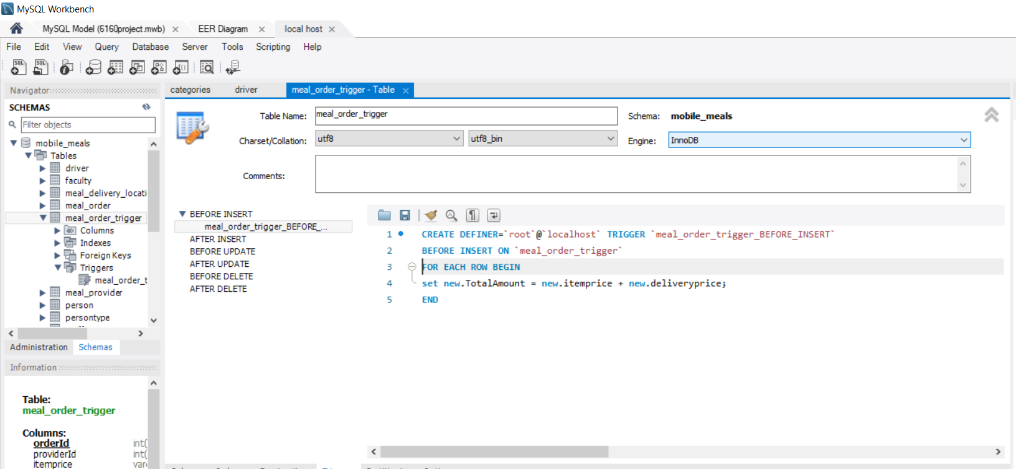
Triggers

Slide 17
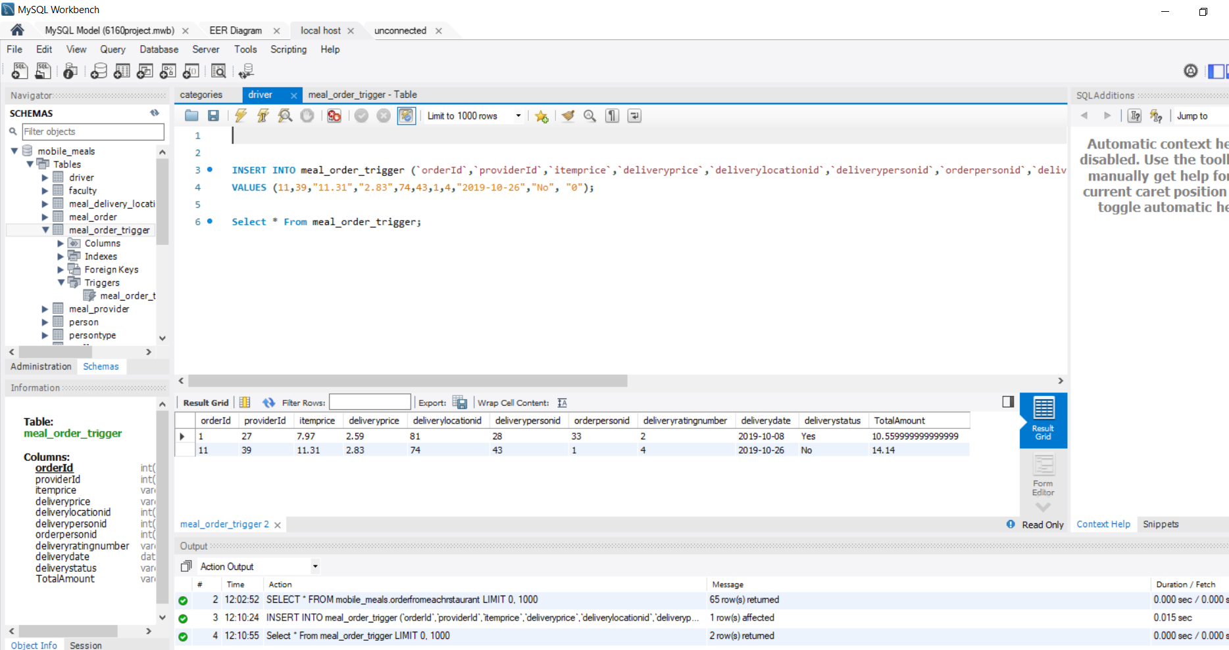
Output for Trigger

Slide 18
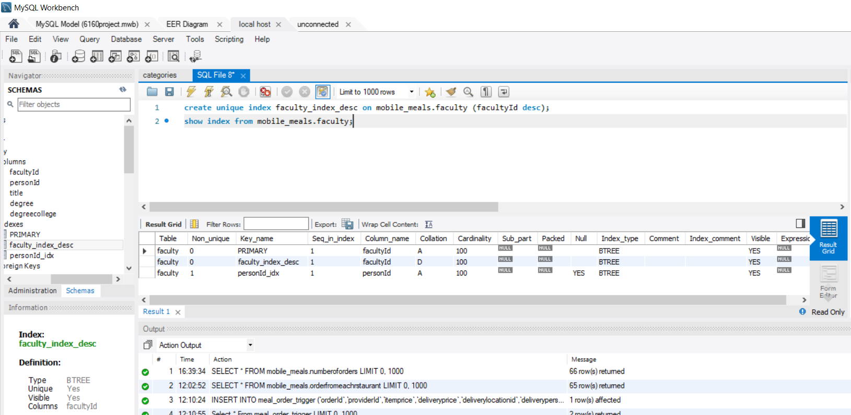
Indexes

Slide 19
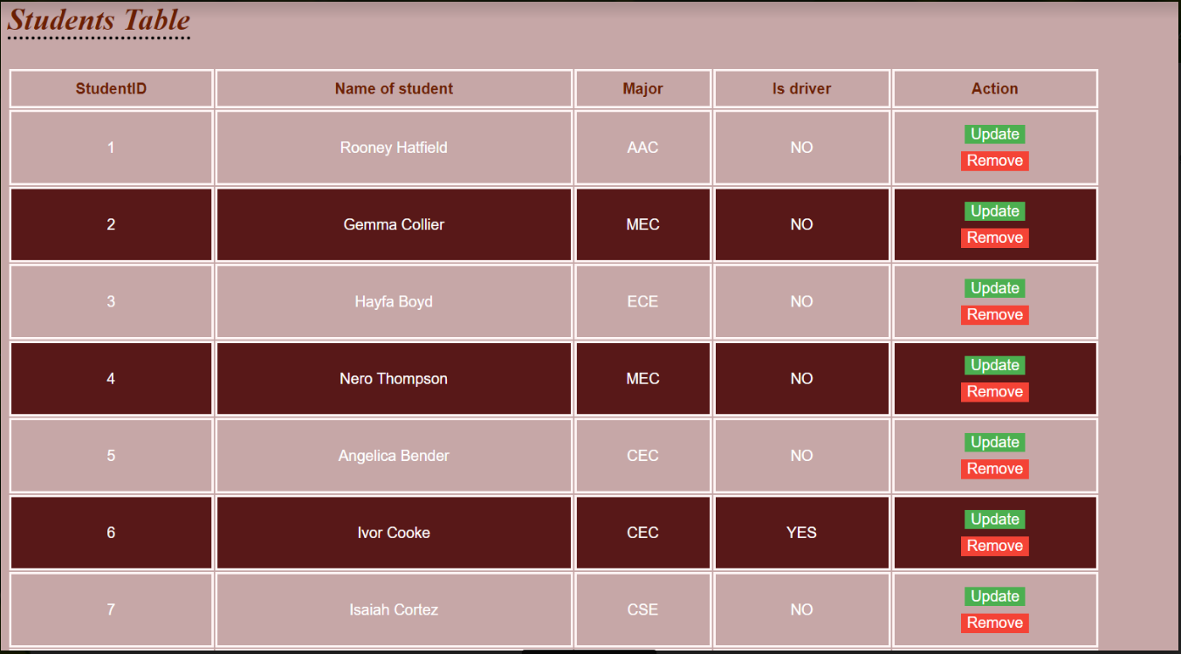
Retrieving Info from MySQL Student to
User Interface

Slide 20
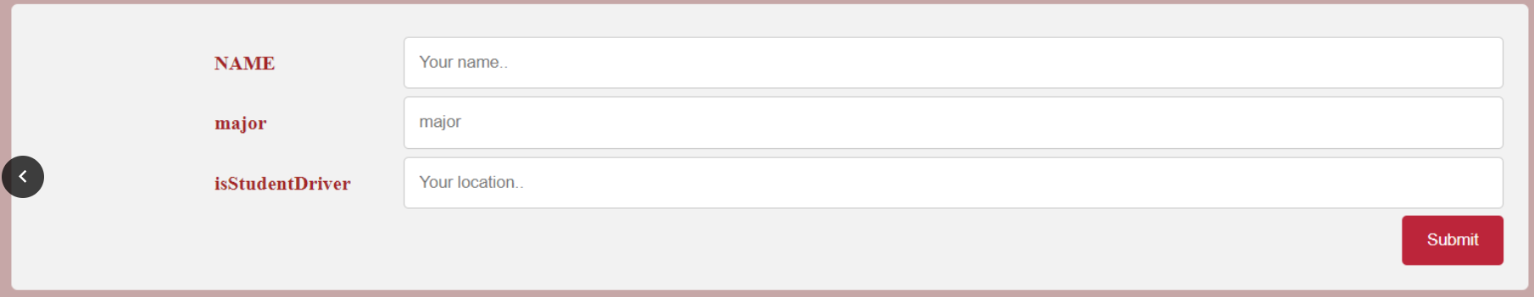
Inserting Info from student table
User Interface to MySQL

Slide 21
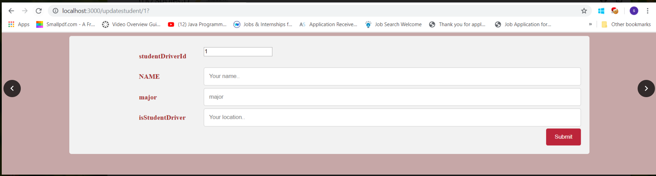
Updating data in Student table

Slide 22
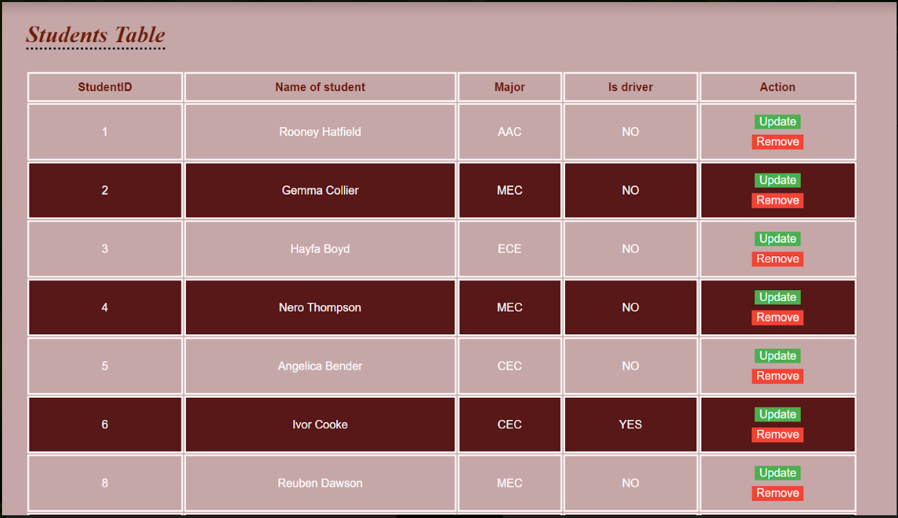
Deleting Row 7 from Student Table

Slide 23
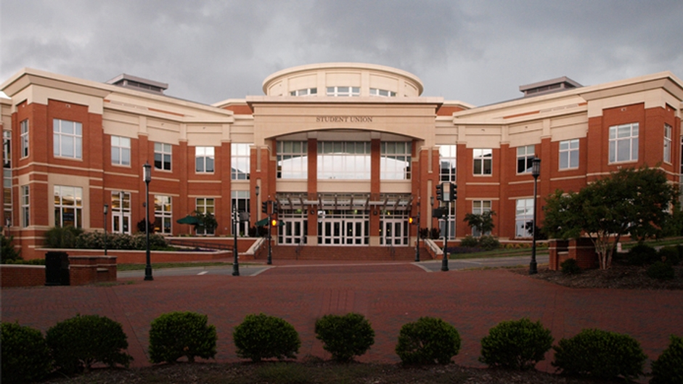
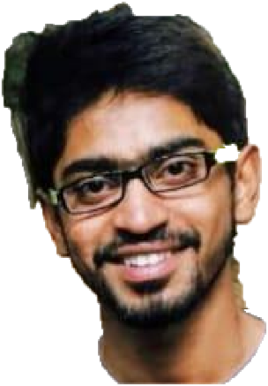
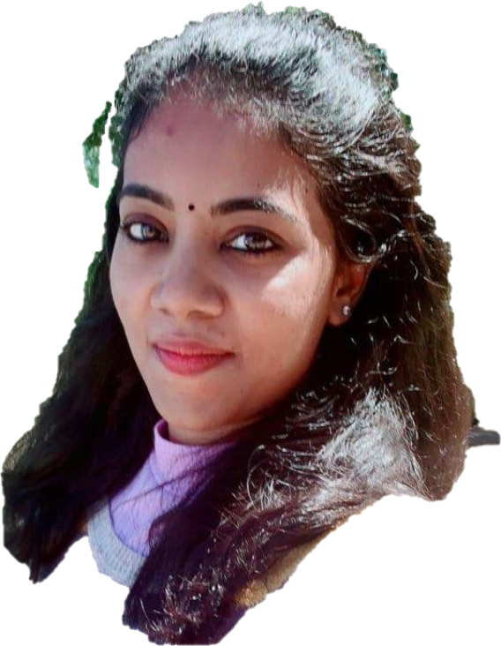
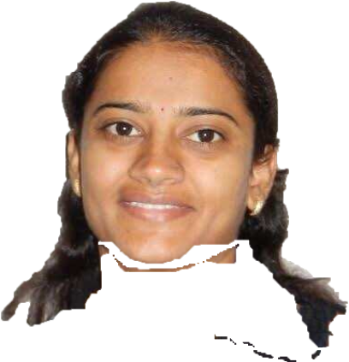
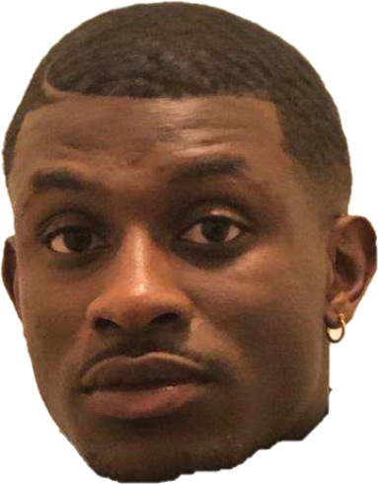
Meet the Team

Slide 24
Thank You

